Slide 1
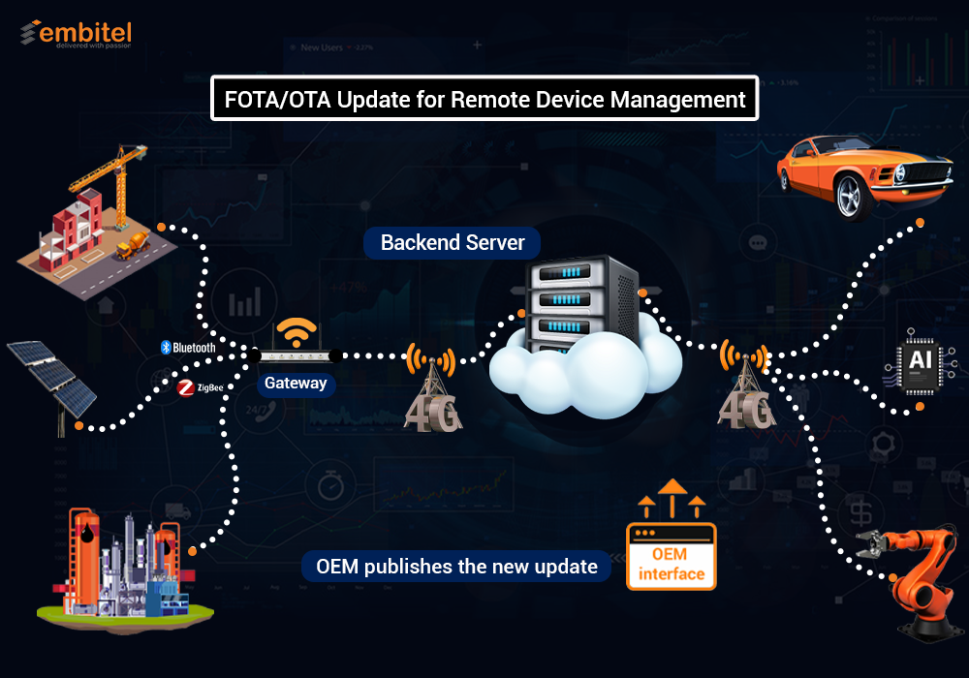



Slide 2

Team Members
Mohamed Hafez Mohamed
Abdelrhman Mosad Abdelhady
Our Team
Osama Salah Hijazi
Supervisor
prof.dr., Sherif Keishk

Slide 3
Agenda
Problem statement.
How OTA can present a solution.
OTA components.
Obstacles of OTA.
Connection between Server and gateway.
Bootloader design.
Security of the software.
Future objectives.
CAN bus.
Autosar standard.
Tools.

Slide 4
Agenda
Problem statement.
How OTA can present a solution.
OTA components.
Obstacles of OTA.
Future objectives.

Slide 5
Problem Statement
The main target of this project is to upgrade software and fix bugs in remote devices based on microcontrollers without going to the device.
What happen to these devices when millions of units have been shipped and a software “enhancement” needs to be made? Does every unit need to be returned to the manufacturer every time the software is updated?
With the gross of fields like IOT and automotive the process of updating and keeping the software clean of bugs have been become harder and harder.

Slide 6

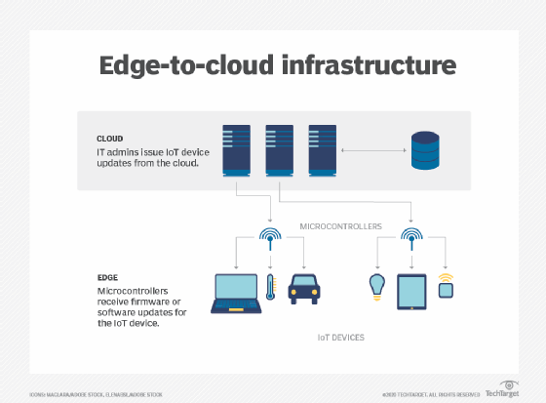
Problem Statement
It is essential for companies to manage the software efficiently over the lifecycle of the device, to provide improvements in performance and to deliver corrections to faulty software that endanger lives or the environment and which could result in expensive product recalls.

Slide 7

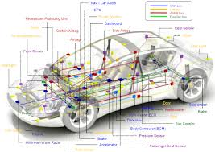

Problem Statement
Examples:
A network in IOT system could have thousands or even millions of embedded devices.
In Automotive a car had at least 20 million to 30 million lines of code and 100 to 200 different ECU.

Slide 8
Agenda
Problem statement.
How OTA can present a solution.
OTA components.
Obstacles of OTA.
Future objectives.

Slide 9
How OTA can present a solution
From the previous illustrate the problem is to reach all these microcontrollers and keep them updated and fix the bugs so, if there is a way to reach them remotely then the problem will be solved.
This is what OTA deliver because OTA is the wireless delivery of new software or data to mobile devices.
The idea is to upload the new update to the cloud and devices will be connected to the cloud so it will receive the new update through any wireless communication.

Slide 10
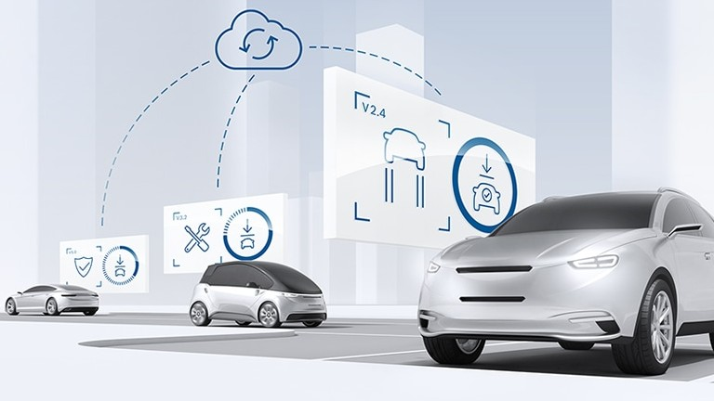
How OTA can present a solution
OTA technology will provide:
It can seamlessly manage firmware updates across a fleet of IOT devices from one unified interface, the costs significantly will decrease.
Bug issues can be fixed and product behavior can be enhanced.
It enables manufacturers to add new features to infrastructure after the release without physical access.
Faster time-to-market.
Improved safety and compliance.

Slide 11
Agenda
Problem statement.
How OTA can present a solution.
OTA components
Obstacles of OTA.
Future objectives.

Slide 12
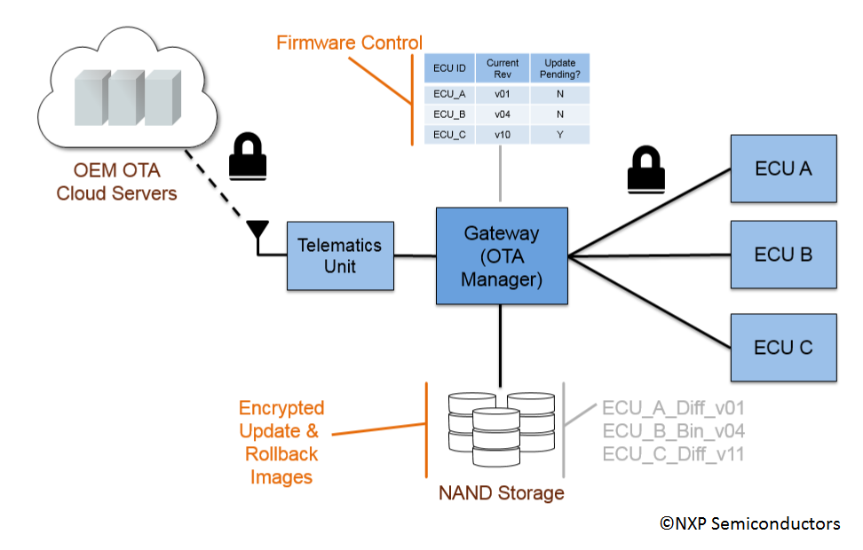
OTA Components

Slide 13
Agenda
Problem statement.
How OTA can present a solution.
OTA components
Obstacles of OTA.
Future objectives.

Slide 14
Obstacles of OTA
Connection between Server and gateway.
Boot-loader design.
Security of the software.

Slide 15
Agenda
Problem statement.
How OTA can present a solution.
OTA components.
Obstacles of OTA.
Connection between server and gateway.
Future objectives.

Slide 16
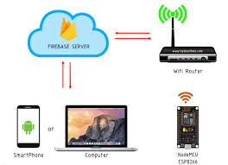
Connection between server and gateway
Connection is made through :
Node MCU as telematics unit.
Firebase ad server.
Friendly GUI to upload updates.
Gateway to control the installation.

Slide 17
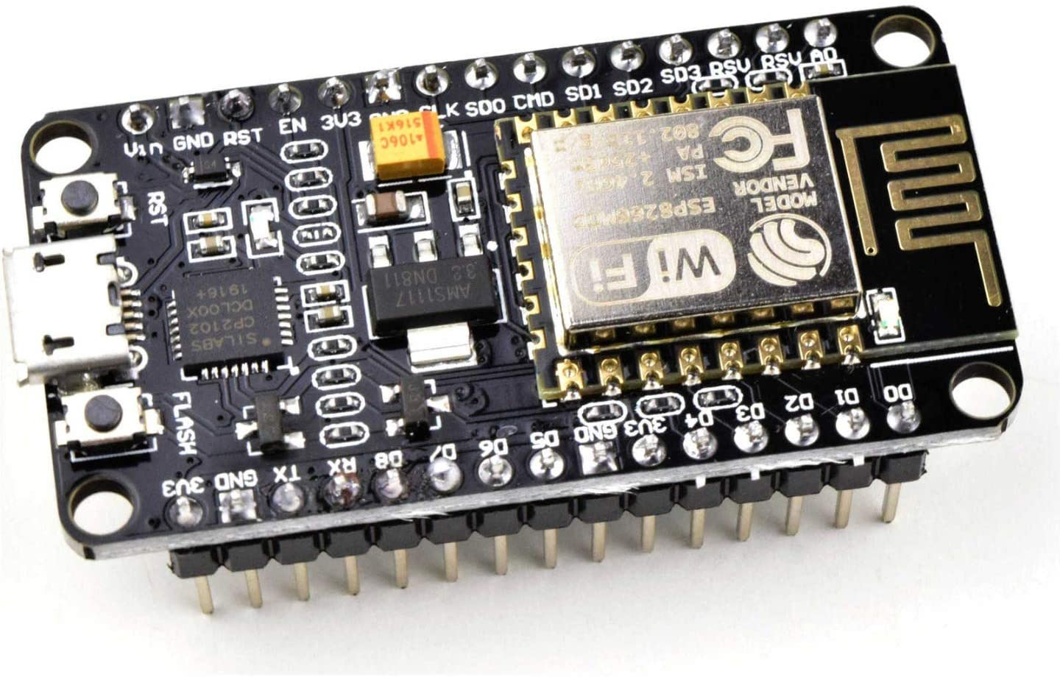
Node MCU
Is an open source development board and firmware based in the widely used ESP8266 -12E Wifi module.
It is our way to connect to internet and download the update.
Easy to program and has stable performance.

Slide 18
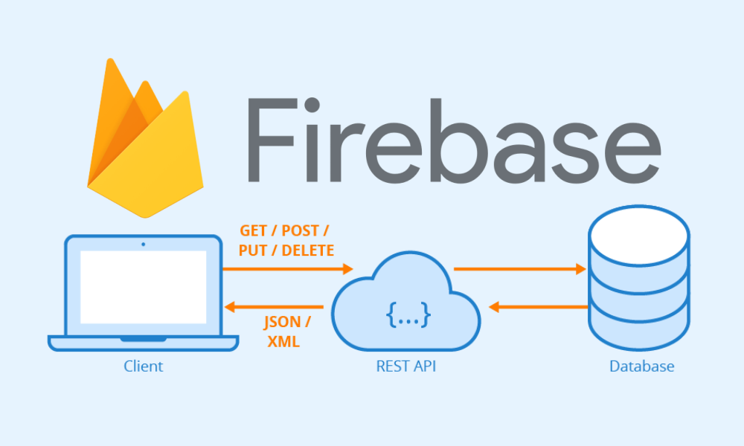
Firebase
Is Google's mobile platform that helps you quickly develop high-quality apps.
Main advantage is the real time database and storage.
It is the server that will connect the remote user to the ES device.
The new code will be uploaded to it from remote PC so the node MCU will download code from it.

Slide 19
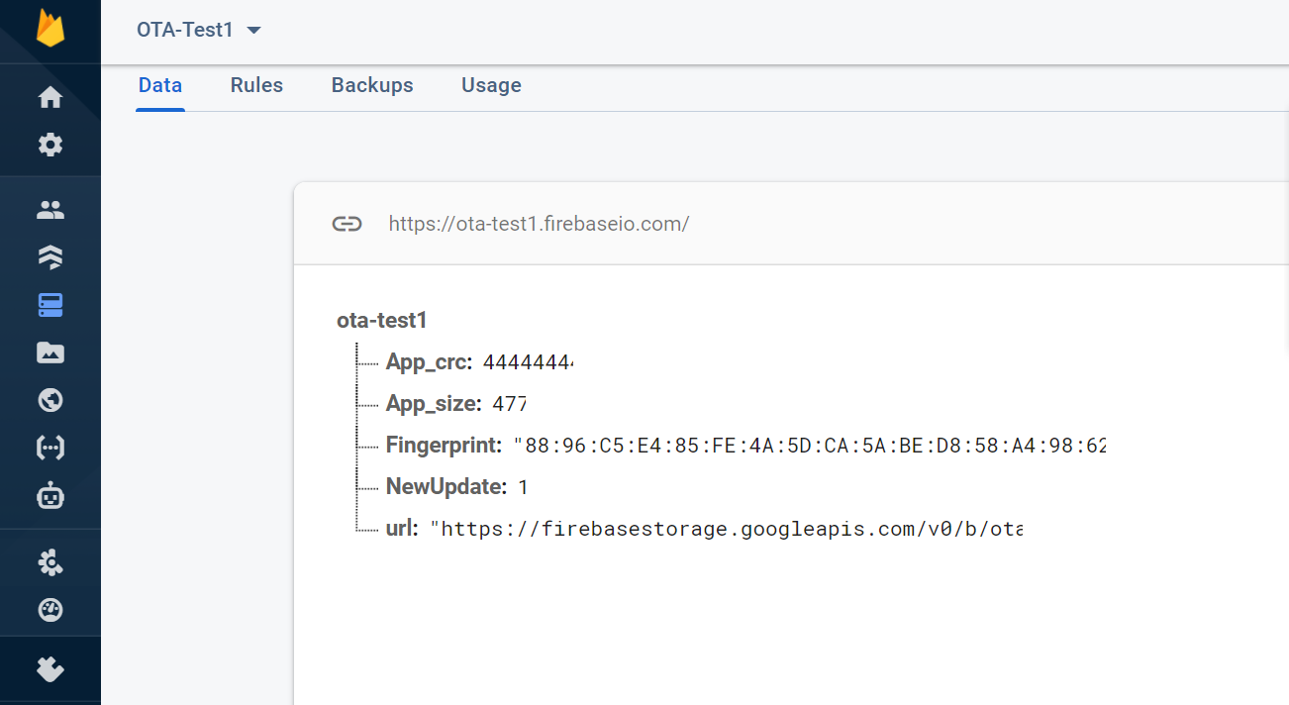
Firebase
Using Real time database for storing information about the update like CRC value and a flag to notify the node of new update.

Slide 20
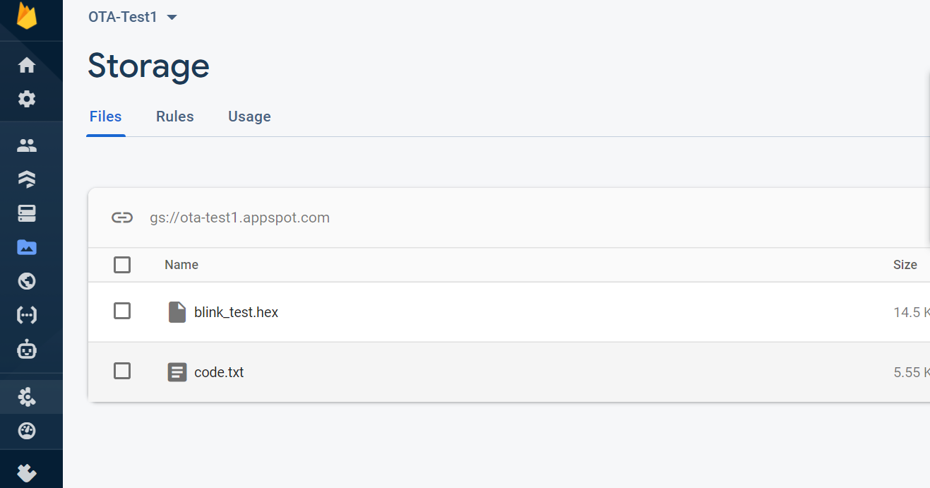
Firebase
Using firebase storage to store the code so node will download it later from the storage.

Slide 21
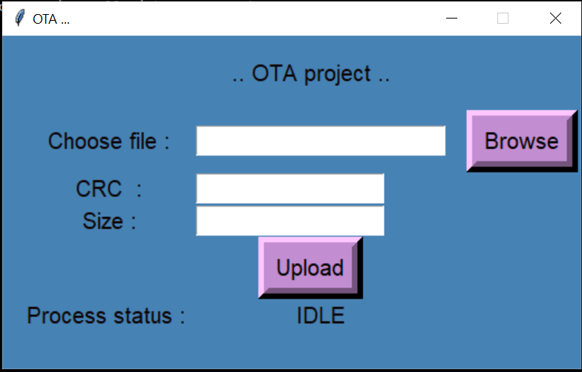
GUI
GUI is to make it easier for the user to upload updates to firebase and the relate information of the update.
If the last update wasn’t downloaded yet by the node the application will block the user from uploading new update.
The application will keep showing the update status till completed.

Slide 22
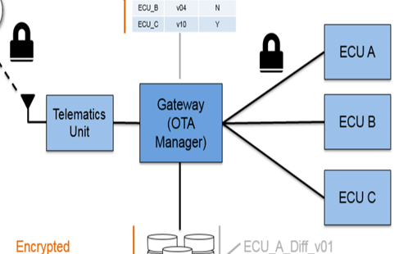
Gateway
Node MCU responsibility is only to download the code and forward it to the gateway.
The gateway responsibility is :
Save information about connected ECUs.
Decrypt the code.
Check if code is valid.
Determine which ECU this code is for.
Resolve dependencies in case of rollback.
Notify the node when the update is complete.

Slide 23
Agenda
Problem statement.
How OTA can present a solution.
OTA components
Obstacles of OTA.
Connection between server and gateway.
Bootloader design.
Future objectives.

Slide 24
Bootloader Design
Main points in Bootloader design:
Bootloader requirements.
Bootloader state machine.
Application behavior.
Bootloader behavior.
Memory partitioning.
Reset and interrupt handling.

Slide 25
Bootloader Requirements
Each boot-loader will have its own unique set of requirements based on the type of application. The following requirements are common to all bootloaders.
Ability to switch or select the operating mode (Application or bootloader).
Communication protocol (USB, CAN, I2C, UART).
Record parsing requirement (S-Record, hex, intel, toeff).
Flash system requirements (erase, write, read, location).
EEPROM requirements (partition, erase, read, write).
Error detection mechanism (checksum, crc,…).
Security and encryption.

Slide 26
Bootloader State Machine

Slide 27
Application Behavior
The application needs to be capable of receiving a command to enter the bootloader.
Reset the system to initiate a branching decision.
Start-Up Branching.
There is a flag to decide which image to load.

Slide 28
Bootloader Behavior
Start the branch code to determine which code ‘ll be executed.
If bootloader will be executed:
Move the active image to backup image if exist.
Receive code record by record on UART and store it in the flash.
Sending hex file records one by one to the bootloader.
Reset branching flag and make software reset.
If there is an image:
Check the image status and CRC to confirm it’s correctness.
Execute image from the active region.
If there is error detected, make flag for it.

Slide 29
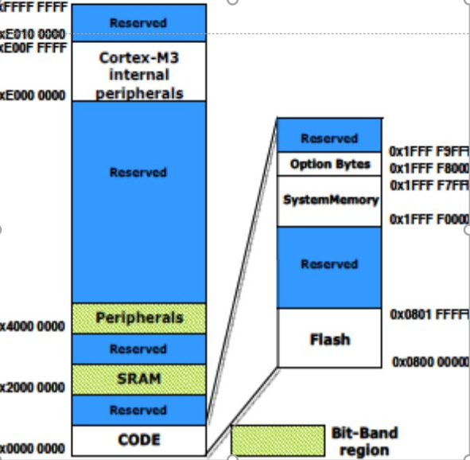
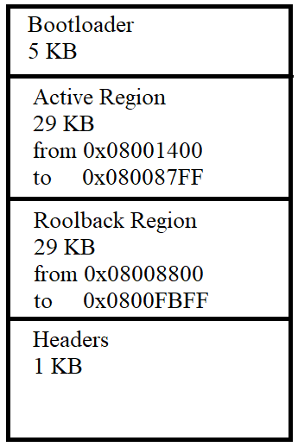
Memory Partitioning

Slide 30
Reset And Interrupt Handling
The reset vector is the location in memory where the first instruction for the application is located. ​
It is still up to the bootloader designer to decide where to place the reset vector.​
The common approach is to relocate it to the address specified by the bootloader.​
The second approach is to have the bootloader itself monitor for the reset vector and put it in the location of its choosing.
The bootloader like any application will need a vector table so an extra vector table that needs to be placed somewhere.​
We must move interrupt vector to a known location.​
This done arm cortex processor using Vector table offset register.​
It contains the offset of the table base from memory address 0x00000000.

Slide 31
Error Detection
A cyclic redundancy check (CRC) is an error-detecting code commonly used in digital networks and storage devices to detect accidental changes to raw data.
Blocks of data entering these systems get a short check value attached, based on the remainder of a polynomial division of their contents.
Our MCU support circuit to calculate crc.
We used it to check the integrity of the images by checking
The calculated one with the received crc sent with code in header.

Slide 32
Agenda
Problem statement.
How OTA can present a solution.
OTA components
Obstacles of OTA.
Connection between server and gateway.
Bootloader design.
Security of the software.
Future objectives.

Slide 33
Security and Encryption Algorithm
We explained previously that we need to upload the code file to Firebase
cloud storage so to prevent hackers attack and manipulation.
The following countermeasures should be applied to secure firmware:
1- Protect the authenticity and integrity of firmware to prevent a hacker
From running modified code.
2- Encrypt the firmware to prevent a hacker from accessing the data.

Slide 34
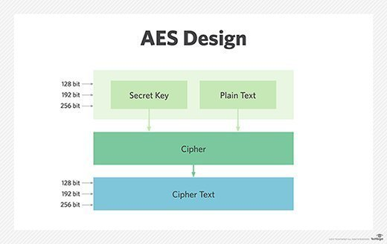
Advanced Encryption Standards (AES)

Slide 35
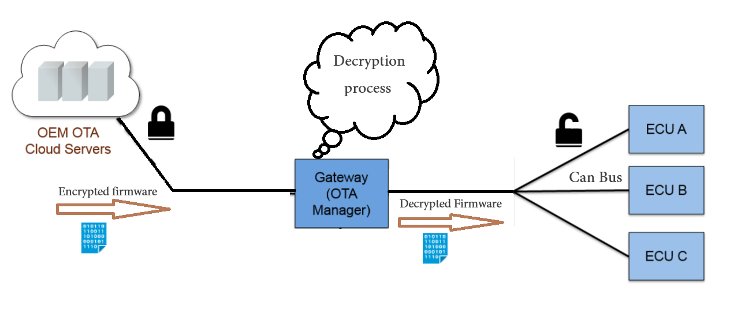
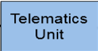
Encryption And Decryption Process

Slide 36
Agenda
Problem statement.
How OTA can present a solution.
OTA components.
Obstacles of OTA.
Future objectives.
CAN bus.

Slide 37
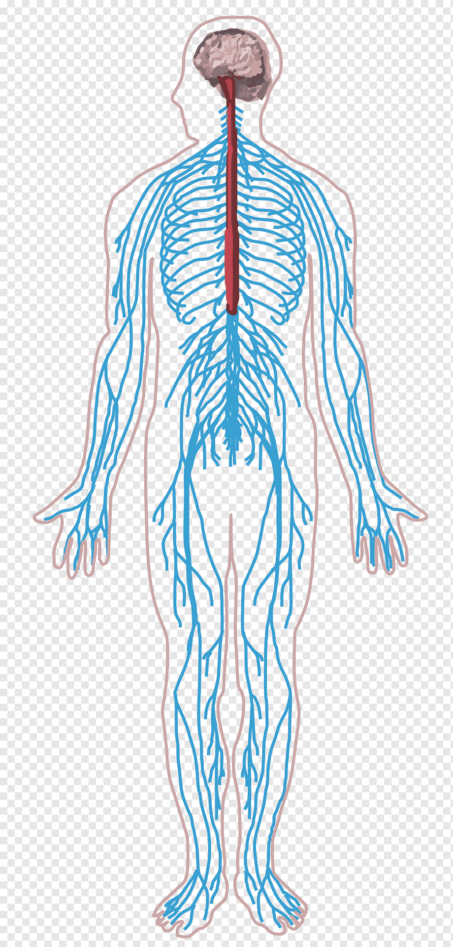
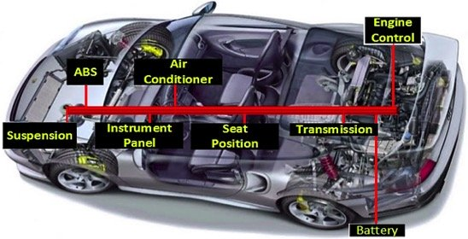
CAN Bus
A Controller Area Network (CAN bus) is a robust vehicle bus
standard designed to allow microcontrollers and devices
to communicate with each other's applications.

Slide 38
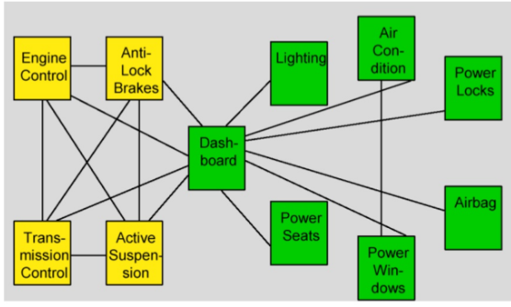
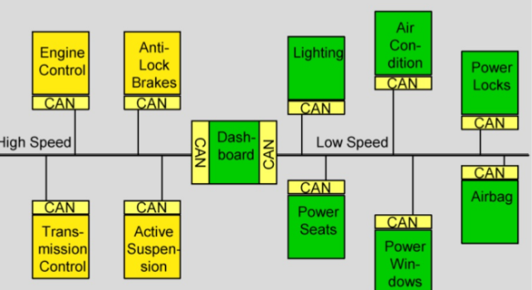
Can Advantages
Allow ECU to initiate standard communication with internal system ECUs
without any overhead.

Slide 39
Can Network Speed
CAN network speed
Data Rate : 1Mbps in CAN and up to 2+ Mbps in CAN-FD.
Bus Length | Bit Rate
40meters | 1 Mbit/sec
100meters | 500 Kbit/sec
200meters | 250 Kbit/sec
500meters | 125 Kbit/sec

Slide 40
Agenda
Problem statement.
How OTA can present a solution.
OTA components.
Obstacles of OTA.
Future objectives.
CAN bus.
Autosar standard.

Slide 41

Autosar Introduction
Automotive Open System Architecture (AUTOSAR) is a global Development partnership of automotive interested parties founded in 2003.

Slide 42
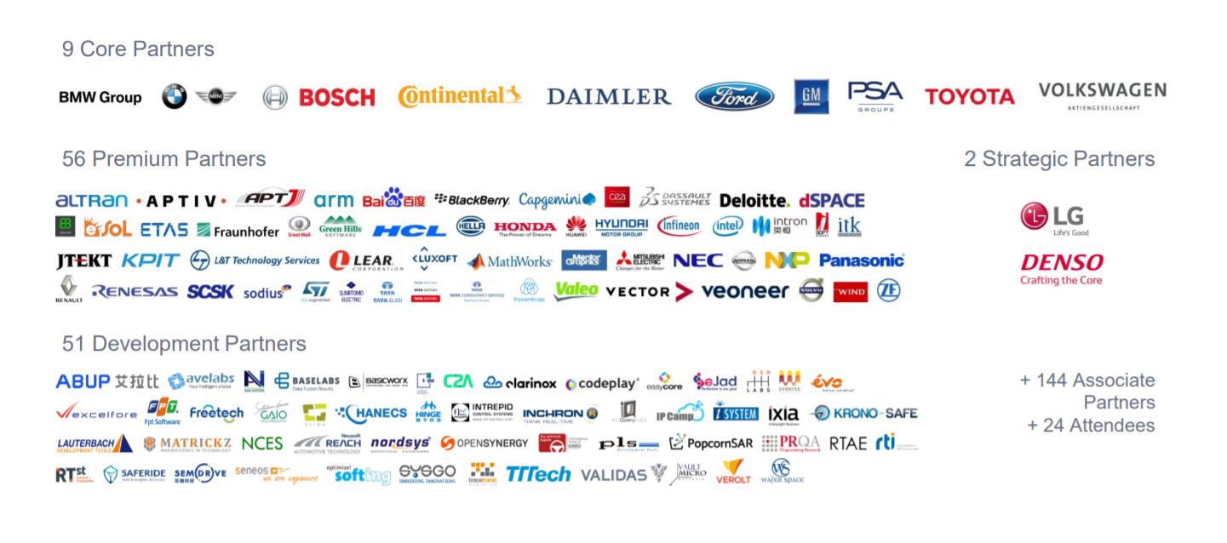
Autosar Partners

Slide 43
Why Autosar ?
Scalability
Avoid SW redundancy by using same standard modules on all ECUs.
Transferability
Ability to transfer a SW Application from an ECU.
Modularity
Ability to custom the SW based on the ECU functionality .
Interoperability
By standardizing interface between different SW Layers enable us using SW
And HW from Different suppliers.

Slide 44
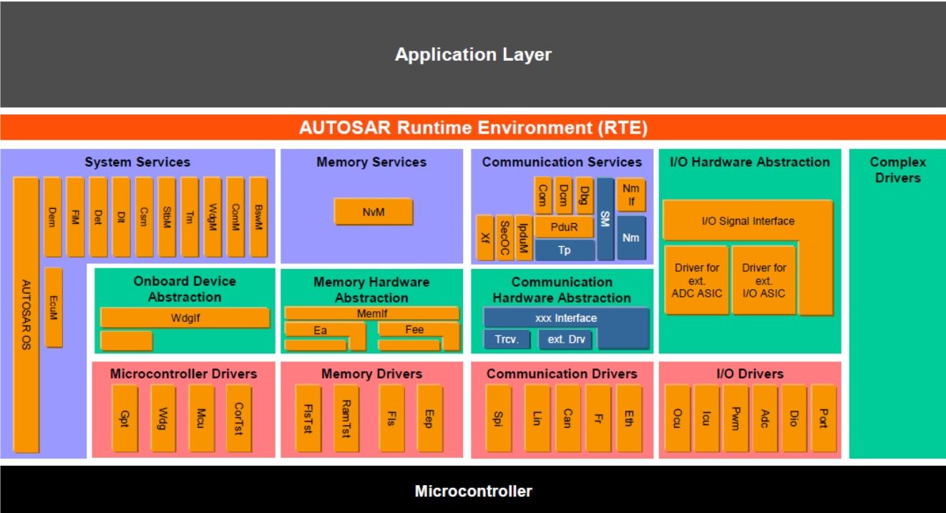
Autosar Layered Architecture

Slide 45
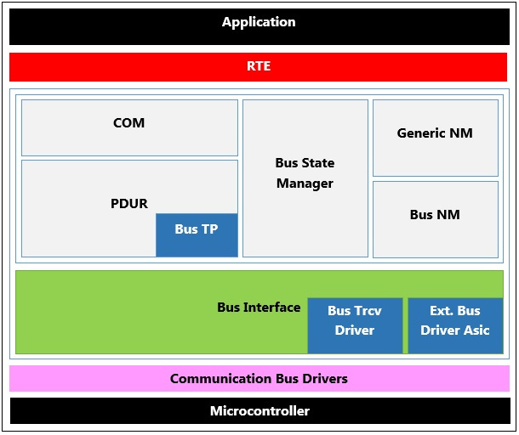
Communication Stack Implementation

Slide 46
Tools
Hardware:
Microcontroller STM32F103C8T6 Based on ARM Cortex-M3 Microprocessor.
NodeMcu.
Editors and IDEs:
VsCode
Keil IDE To Program Microcontrollers based on arm microprocessor.
st_Link utility for flashing code.
Version control and Repository:
git for version control to record changes in files.
github to allow for seamless collaboration without compromising the integrity of the original project.
Github repo:
https://github.com/mohamed-hafez-mohamed/Graduation_Project_2021

Slide 47
Thank you

